Slide 1
Power BI
Please Refer to the .pbix file for actual requirements

Slide 2
Customer Questions for data visualization

Slide 3
User Behavior:
1. Calculate active users (users who have logged in at least once in the past
30 days).
2. Determine the most popular treatments or services users are booking.
3. Identify the average time spent on the app by user category (e.g., beautician vs. prescriber).

Slide 4
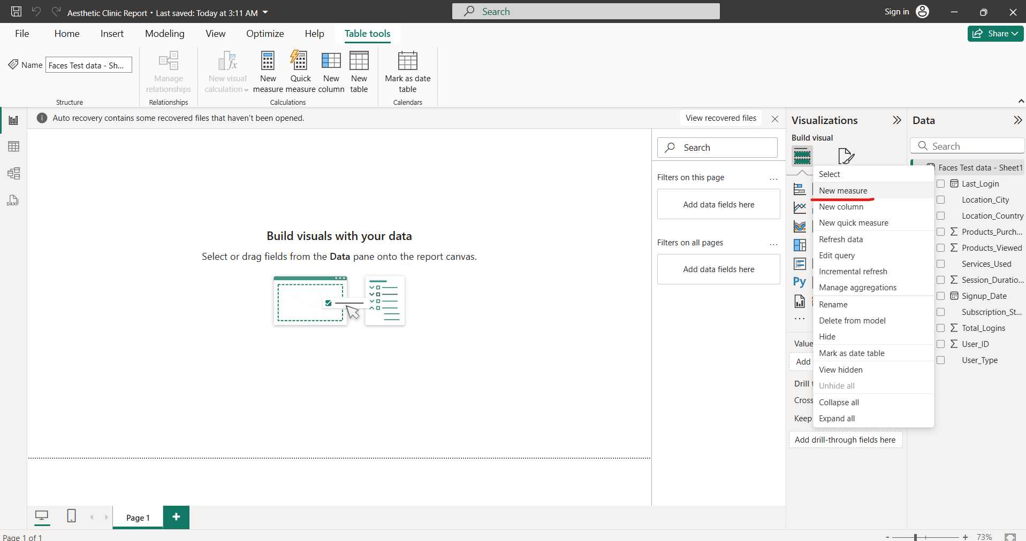
1. For Active users -> Create a new Measure

Slide 5
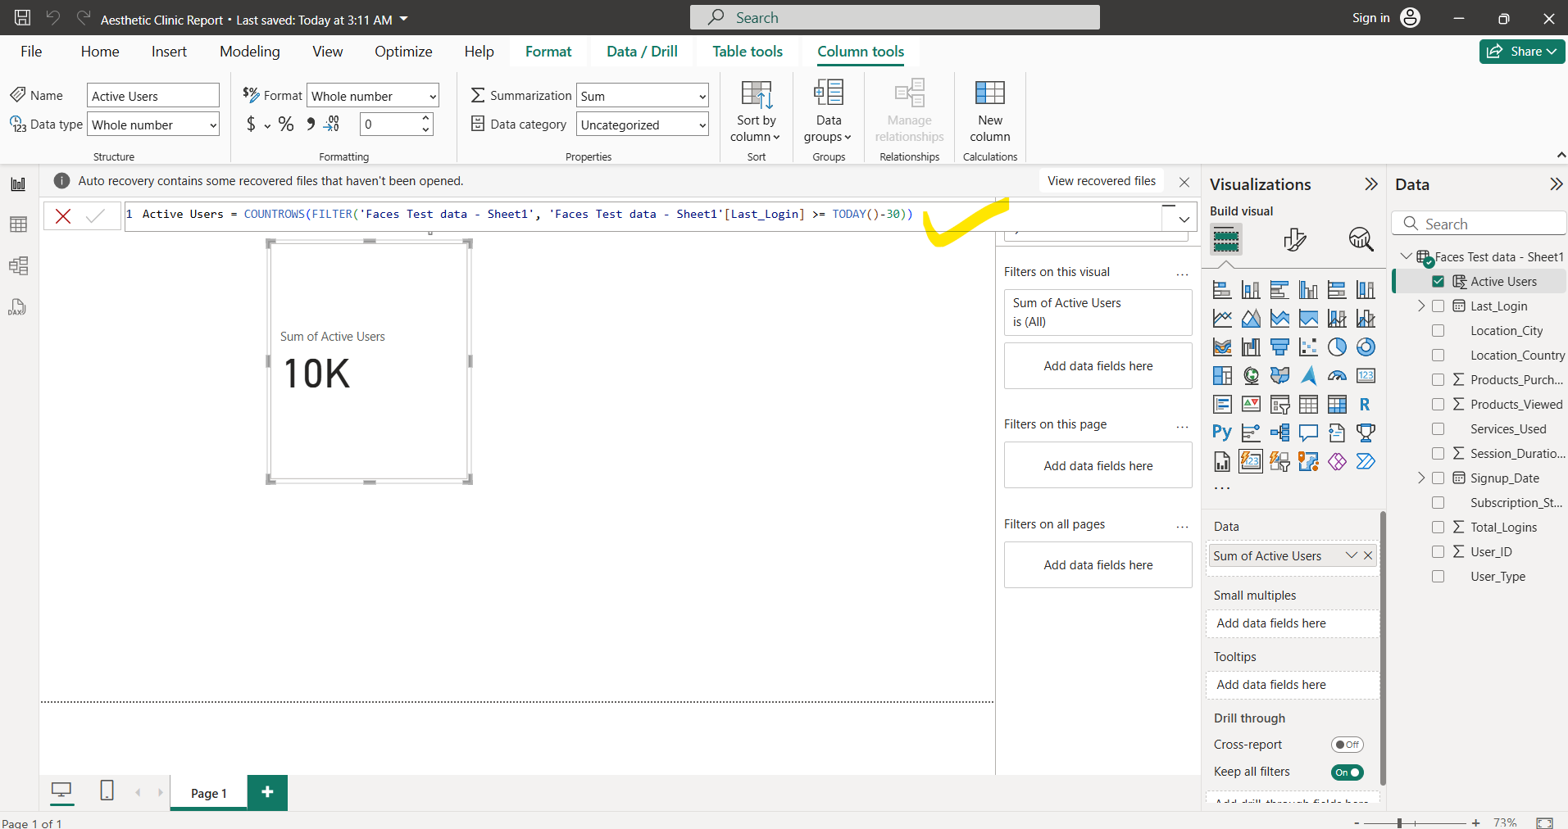
Use Formula “Active Users = COUNTROWS(FILTER('Faces Test data - Sheet1', 'Faces Test data - Sheet1'[Last_Login] >= TODAY()-30)) ”

Slide 6
Formula
TODAY() - 30 in Excel or Power BI returns the date that is 30 days before today's date.
TODAY() gives the current date. Subtracting 30 decreases the date by 30 days.
For example, if today is March 23, 2025, then:
TODAY() - 30 → February 21, 2025.

Slide 7
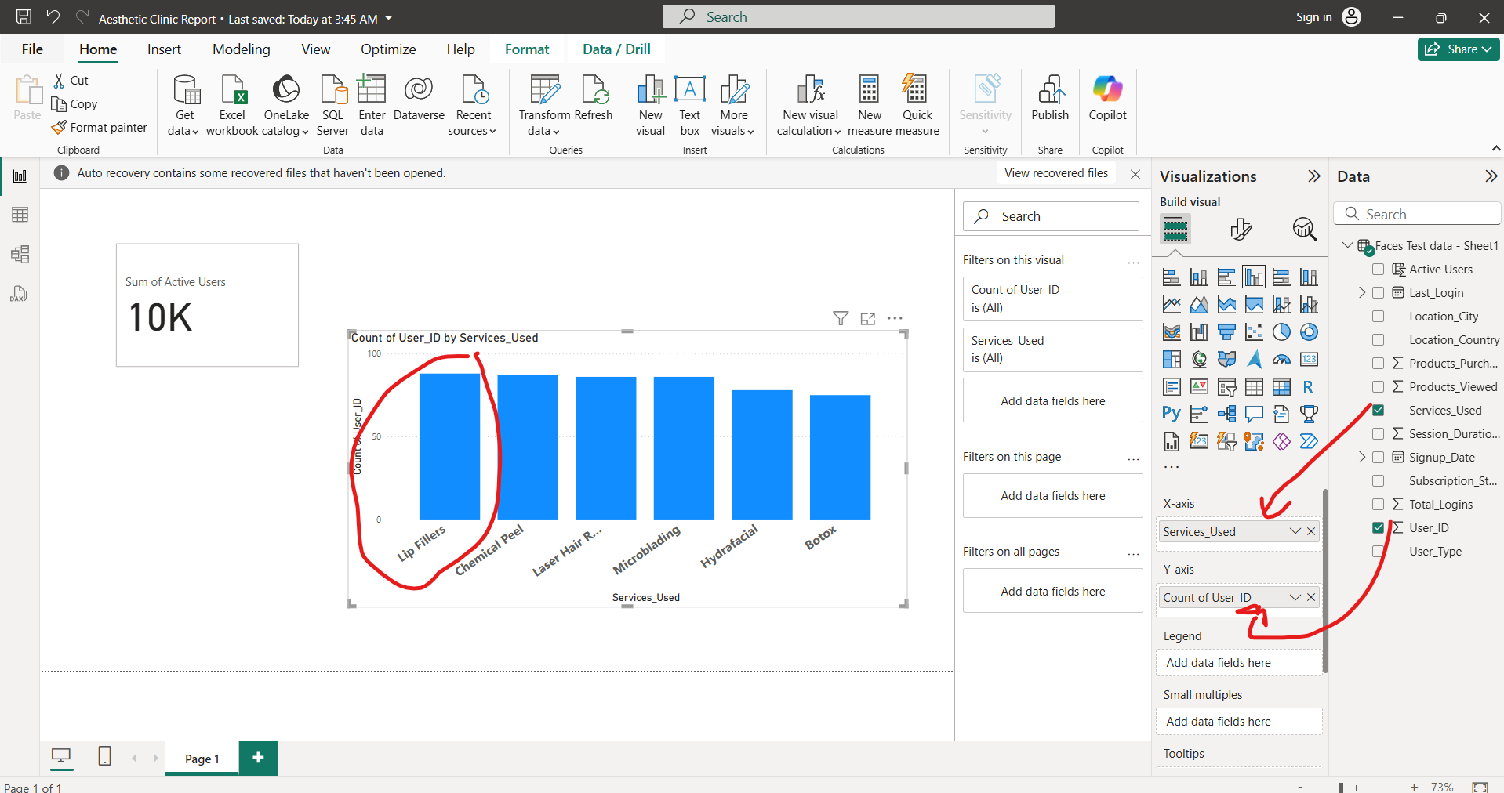
2. Most Popular treatment or services

Slide 8
2.
Most popular treatments are Lip fillers

Slide 9
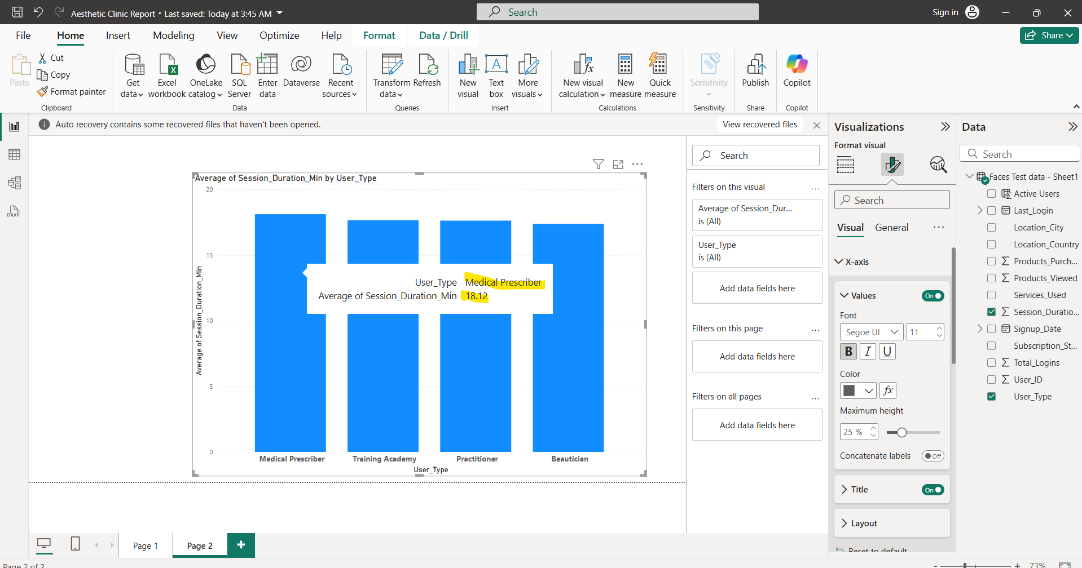
3. Identify the average time spent on the app by user category (e.g., beautician vs. prescriber).
Answer: On average Medical partitional spent the most time on app

Slide 10
✅ Geographic Trends:
1. Identify top regions or countries where Faces is most used. 2. Create a percentage breakdown of users by location.

Slide 11
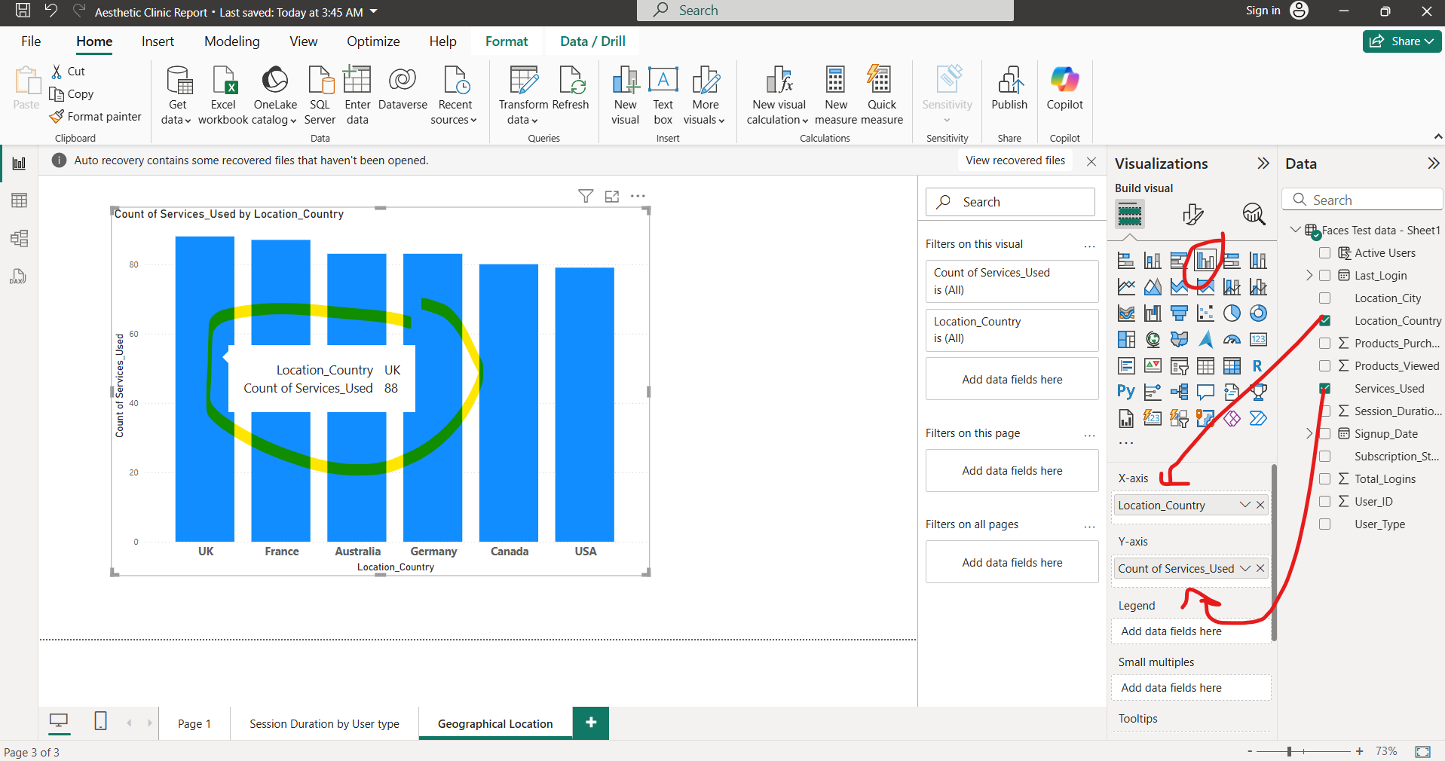
1. Identify top regions or countries where Faces is most used. .(Count of Service used by location )

Slide 12
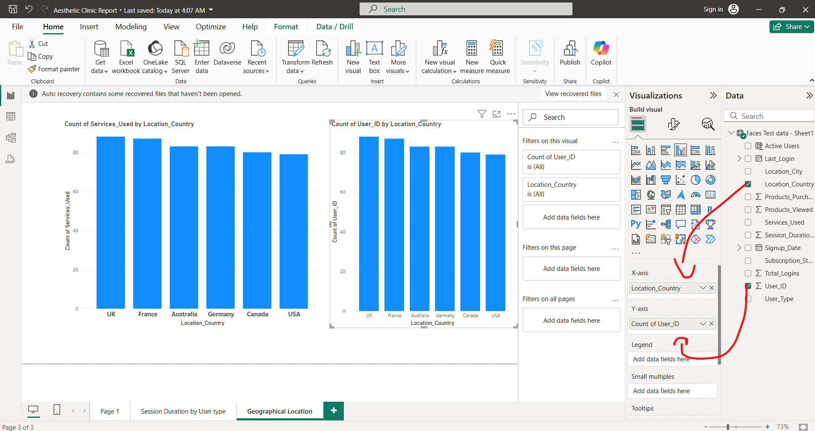
Identify top regions or countries where Faces is most used.(Count of user Id by location )

Slide 13
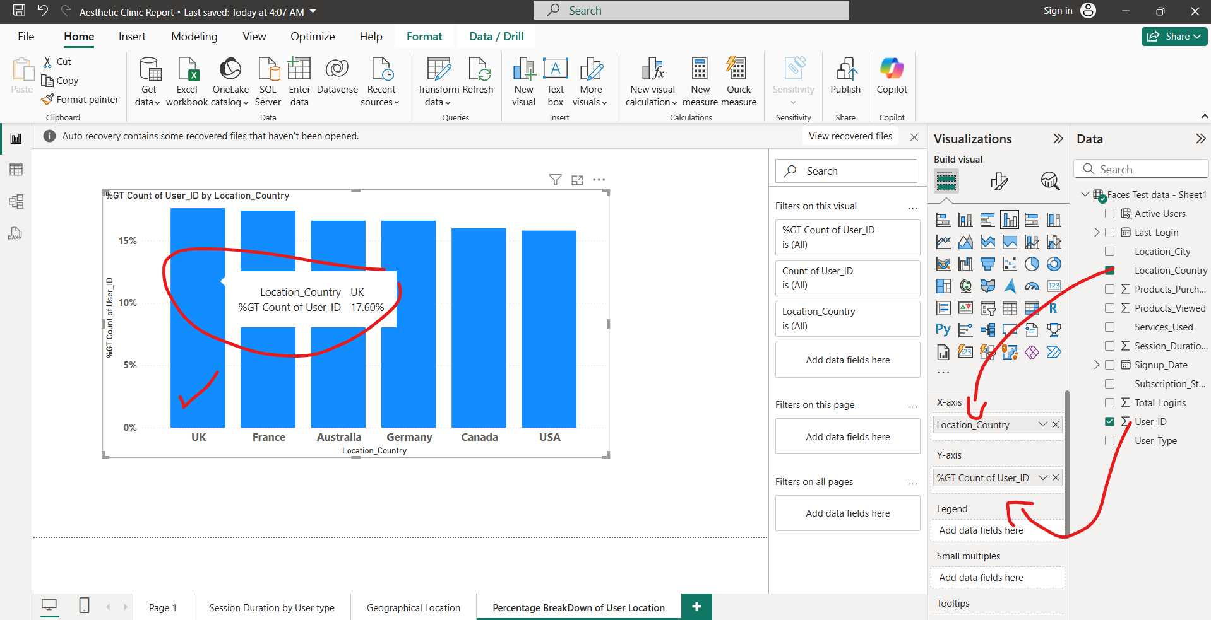
2. Create a percentage breakdown of users by location.
Answer: Grant total of count percentage by Location. UK and France is trending in getting max treatments

Slide 14
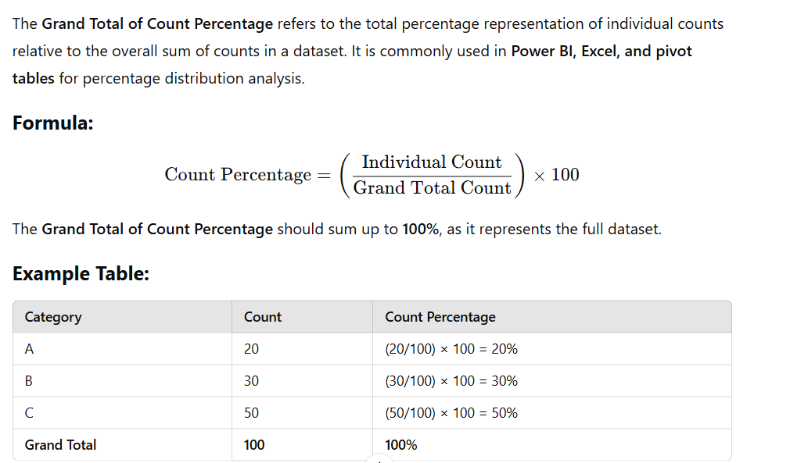
What is GT of count Percentage

Slide 15
✅ Engagement & Retention
Find the percentage of repeat users (users who have logged in more than 3 times in the last month).
Identify drop-off rates (users who signed up but never used Faces).

Slide 16
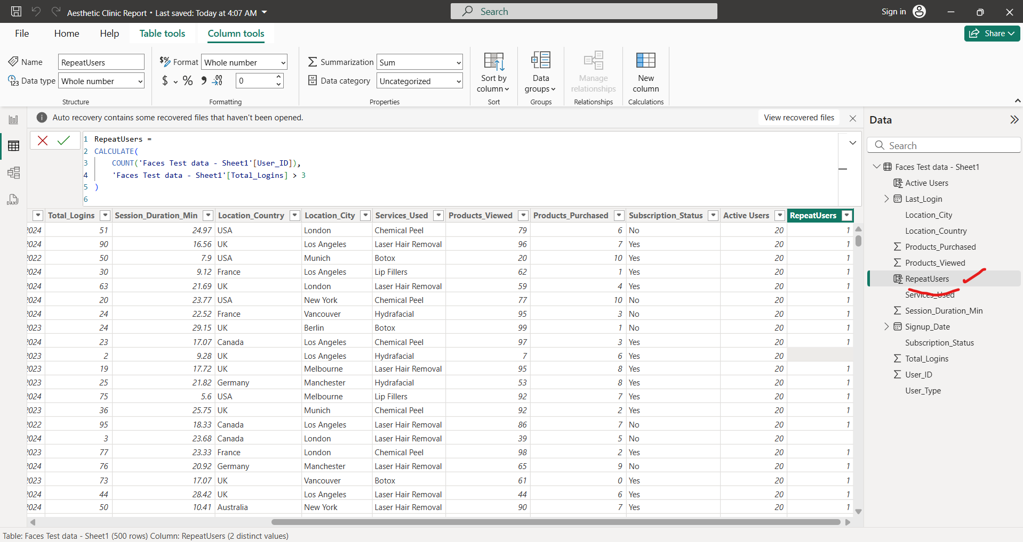
1. Find the percentage of repeat users (users who have logged in more than 3 times in the last month).
Answer: Create a column of repeated users and write formula “RepeatUsers =
CALCULATE(
COUNT('Faces Test data - Sheet1'[User_ID]),
'Faces Test data - Sheet1'[Total_Logins] > 3
)
”

Slide 17
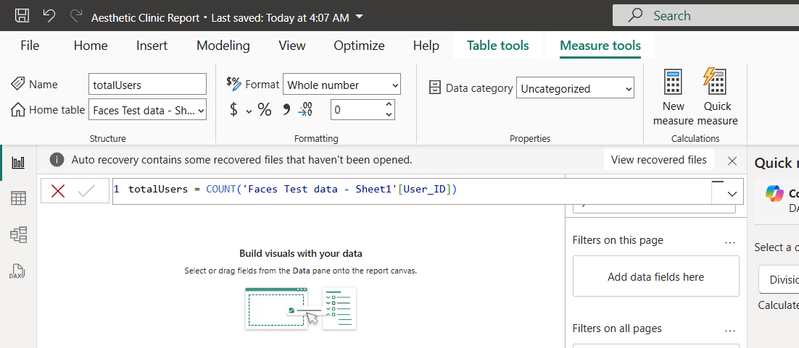
Create another measure named “Totaluser”

Slide 18
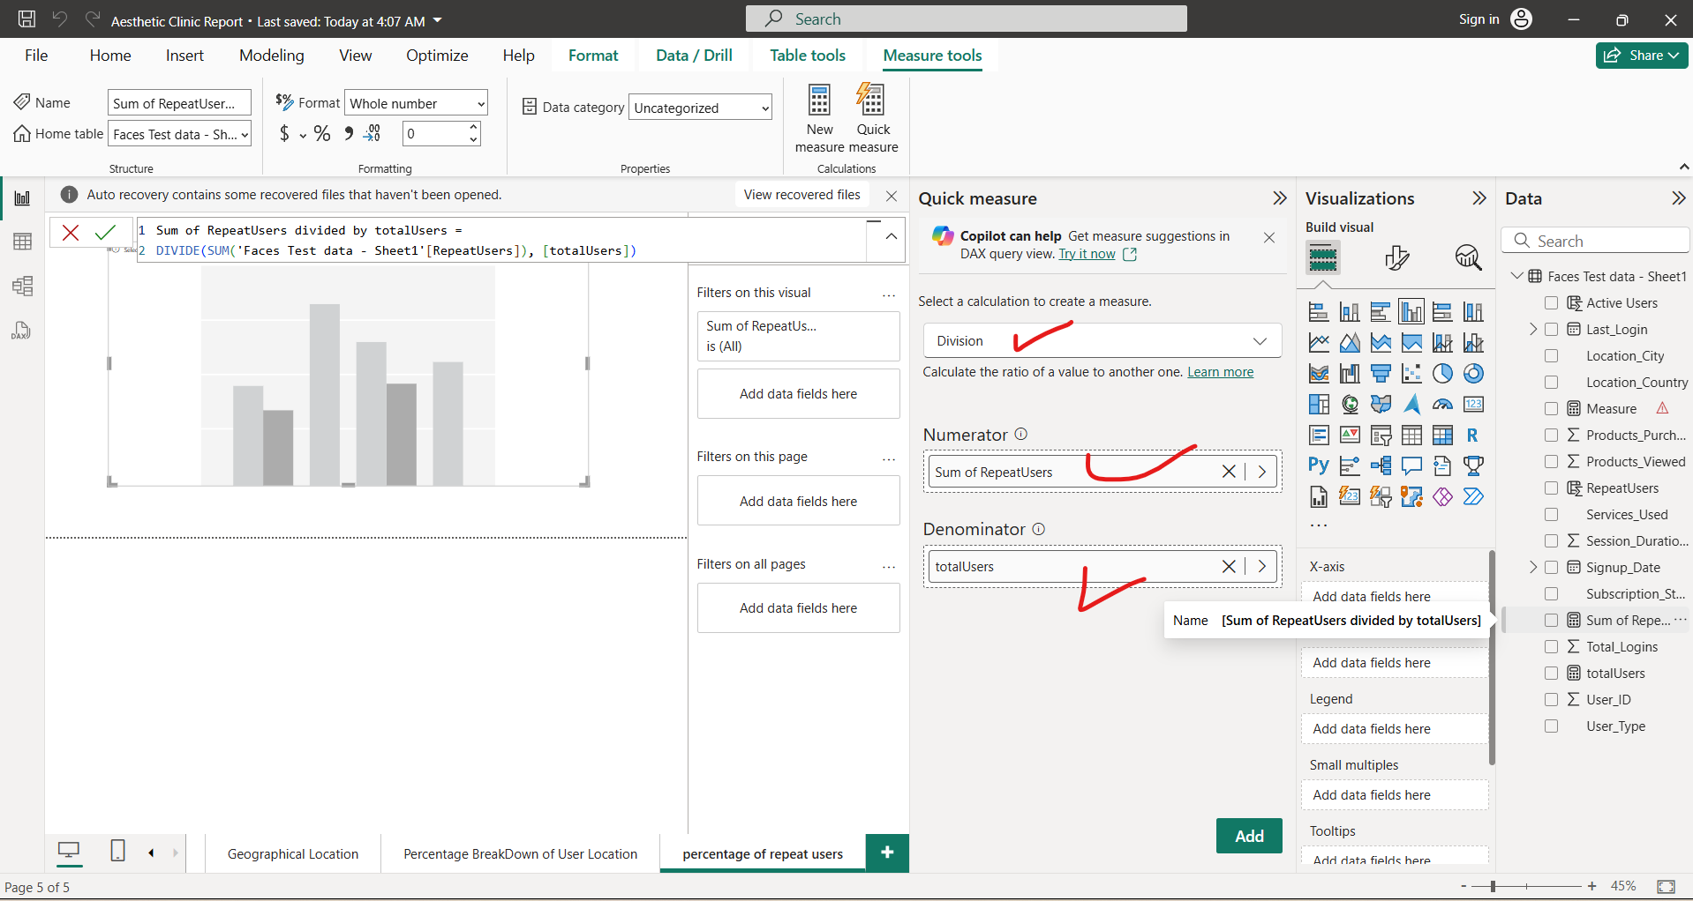
Create a quick Measure

Slide 19
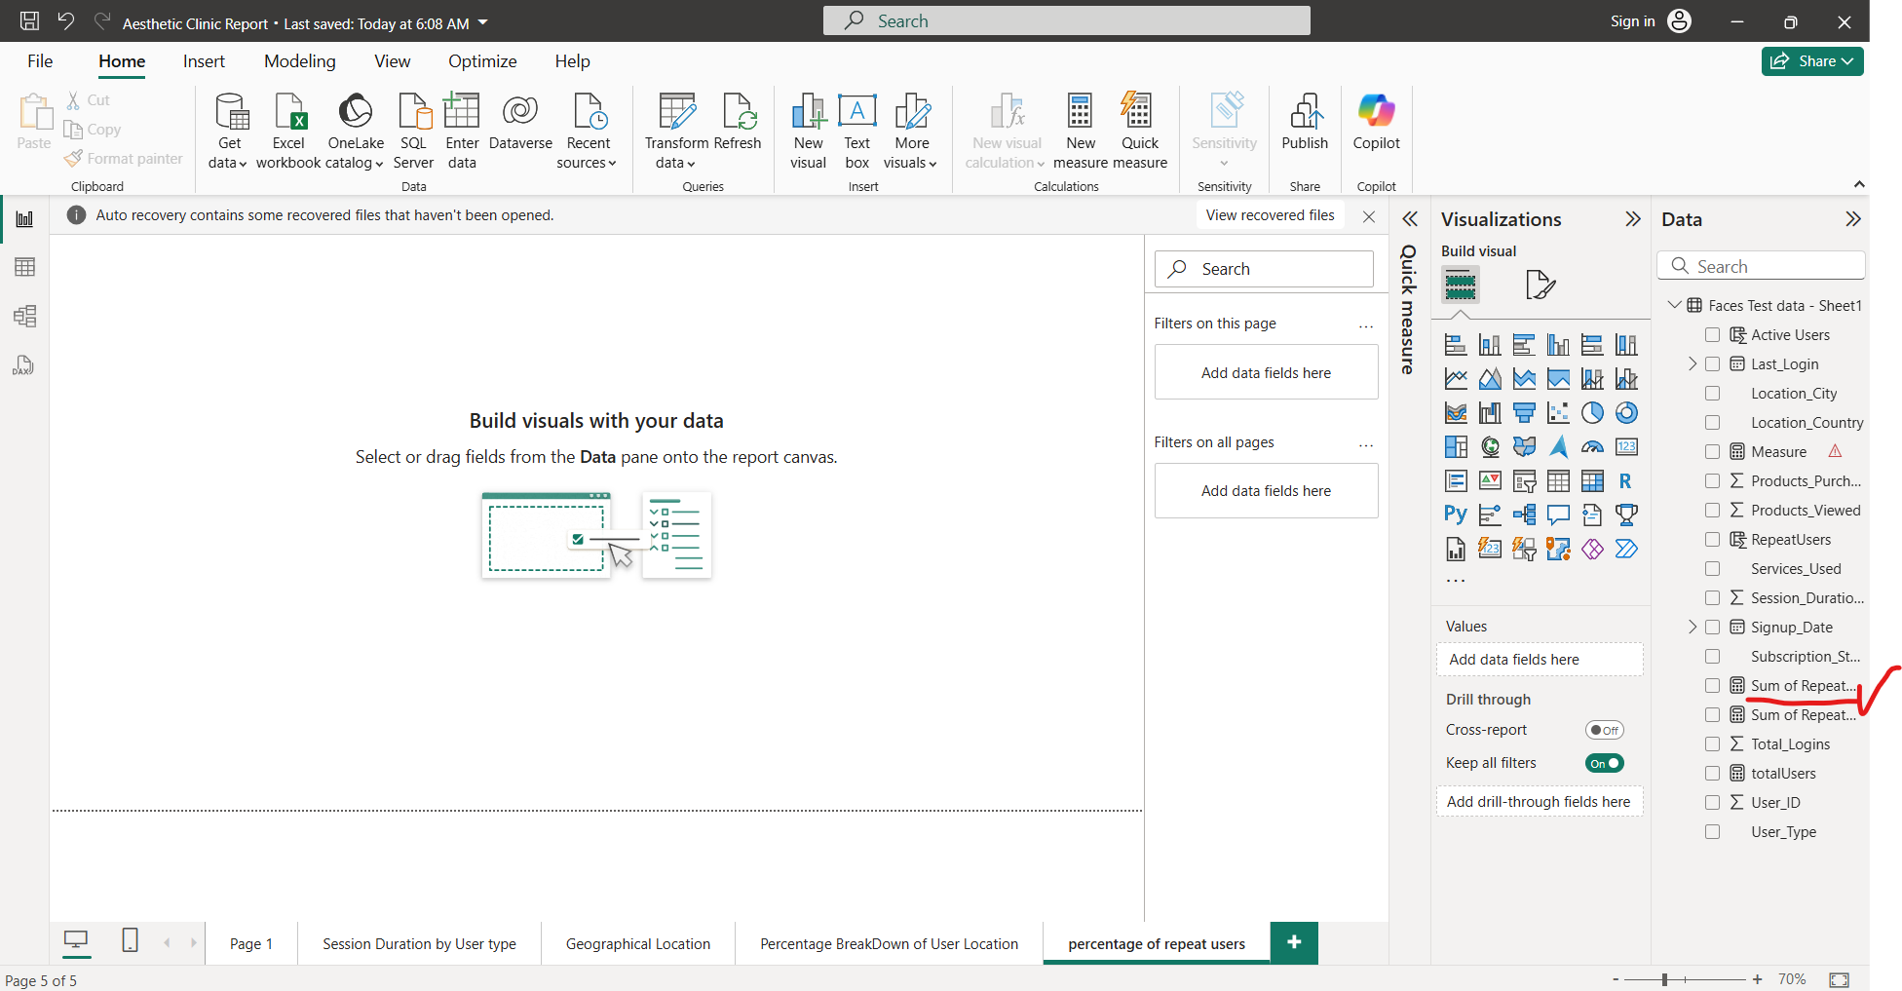
Quick measure created which is “Sum of RepeatUsers divided by totalUsers 2”

Slide 20
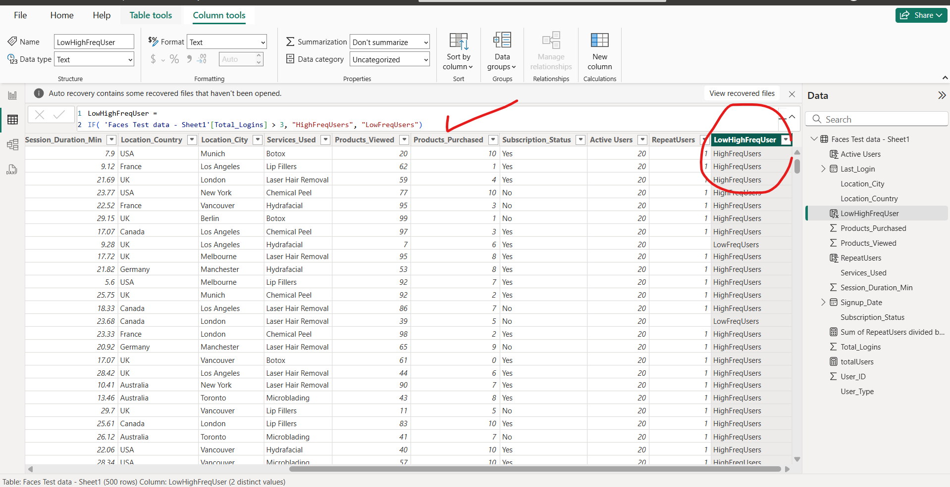
Create a column which states High and low freq user using formula “LowHighFreqUser = IF( 'Faces Test data - Sheet1'[Total_Logins] > 3, "HighFreqUsers", "LowFreqUsers") ”

Slide 21
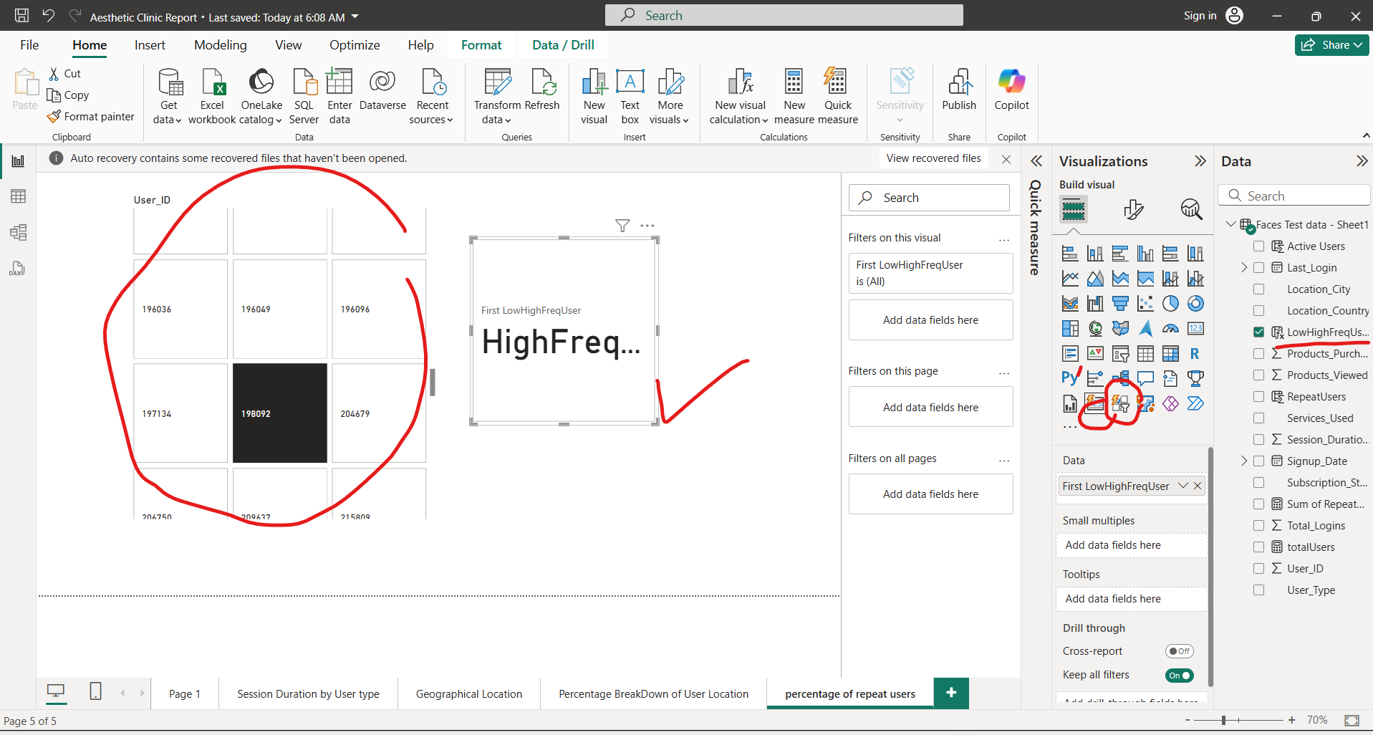
Create visuals Card and slicer showing user id with low and high freq

Slide 22
2. Identify drop-off rates (users who signed up but never used Faces).
There are no drop-off rates where client has not avail any services

